Slide 1
Context: Two Lessons
Lesson 1 covers Behavior analysis as part of the planning and mission analysis process. Output is the following:
Specific Behaviors are often done to achieve or prepare for the SMO
Implied Behaviors required to achieve the SMO but unable to be observed
Essential Behaviors required to achieve the SMO
Lesson 2 covers Target Audience Analysis

Slide 2
Research Supporting MISO
Receive the Mission
Review MISO Programs
Review MISO Series
Mission Analysis
MO Analysis
COA DEV
Supporting MISO Objective (SMO) Development
PTA Development
Prepare Planning Guidance
Prepare Friendly Assessment
Area Analysis
Update or Prepare
PMESII-PT
Prepare CONOP Sketch
MA Brief
Review Previous MA Brief
Review Previous COA Brief
COA Analysis
Review Enemy COA, Staff Estimates, CCIRs
Review Refined Operational Approach
Prepare Evaluation Criteria
Prepare Risk Assessment
Prepare Operational Protection
Mission Statement Approved
Conduct COG Analysis
Request Staff Estimates
Review: MO, PTAL, Themes, Limitations
Refined COAs
Synchronization Matrices
Potential Decision Points
COA vs Evaluation Criteria
COA Comparison
COA vs Enemy COAs
Resource Requirements
Evaluated COA Scores
Prepare Recommended COA
Prepare Revised CCIR
Prepare Differences, Advantages, Risks
COA Decision Brief
Adjustments to COA
Adjustments to CDR’s Intent
Updated CDR’s Estimate
Approved COA

Slide 3
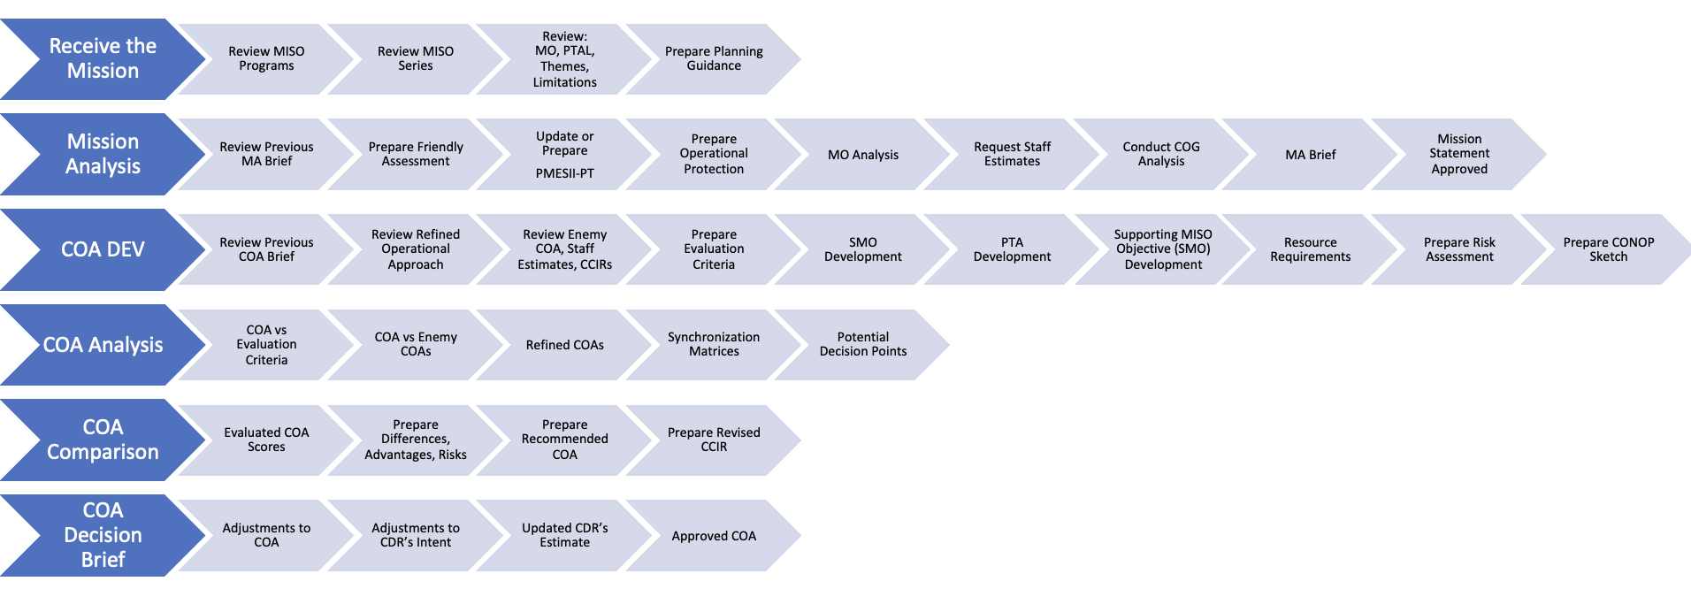
Research Supporting TAAW

Slide 4
Research Supporting TAAW

Slide 5
Research Supporting TAAW

Slide 6
Research Supporting TAAW

Slide 7
Research Supporting TAAW

Slide 8
Research Supporting TAAW

Slide 9
Context Slide
The first section is student-focused, with little engagement from the instructor.
This section is an opportunity for students to “tinker” with ideas and to come to self-realization
Instructors can guide them with questions
This section should highlight or identify the problem; the next section will provide the solution.
Concrete Experience

Slide 10
Explain Yourself
Describe the process for selecting the appropriate TA and Supporting MISO Objective (SMO) match on paper.
Consider what you would do, what you have done, or what you think someone doing this would do.
Discuss this with your classmate
4 Minutes

Slide 11
Context Slide
The problem has been identified, calling back to the problems the students encountered but without directly answering them:
Introduce the sections of the lesson
Tie headlines back to the problem identified
Publish & Process

Slide 12
Agenda
The Traditional System
Breaking Down Behaviors
The COM-B System
Leveraging COM-B for Influence

Slide 13
Context Slide
This section will cover planning for research, typically starting with the desired end state or Supporting MISO Objective (SMO).
Students will be guided on breaking down a task or behavior into a supply chain-like graph requiring research within the area of operation.
The Behavior / Tasks are independent of any Target Audience
The Behavior / Tasks are dependent on Time and Place
Deadlines, Laws, Norms, Opportunity to Perform
Generalize New
Information

Slide 14
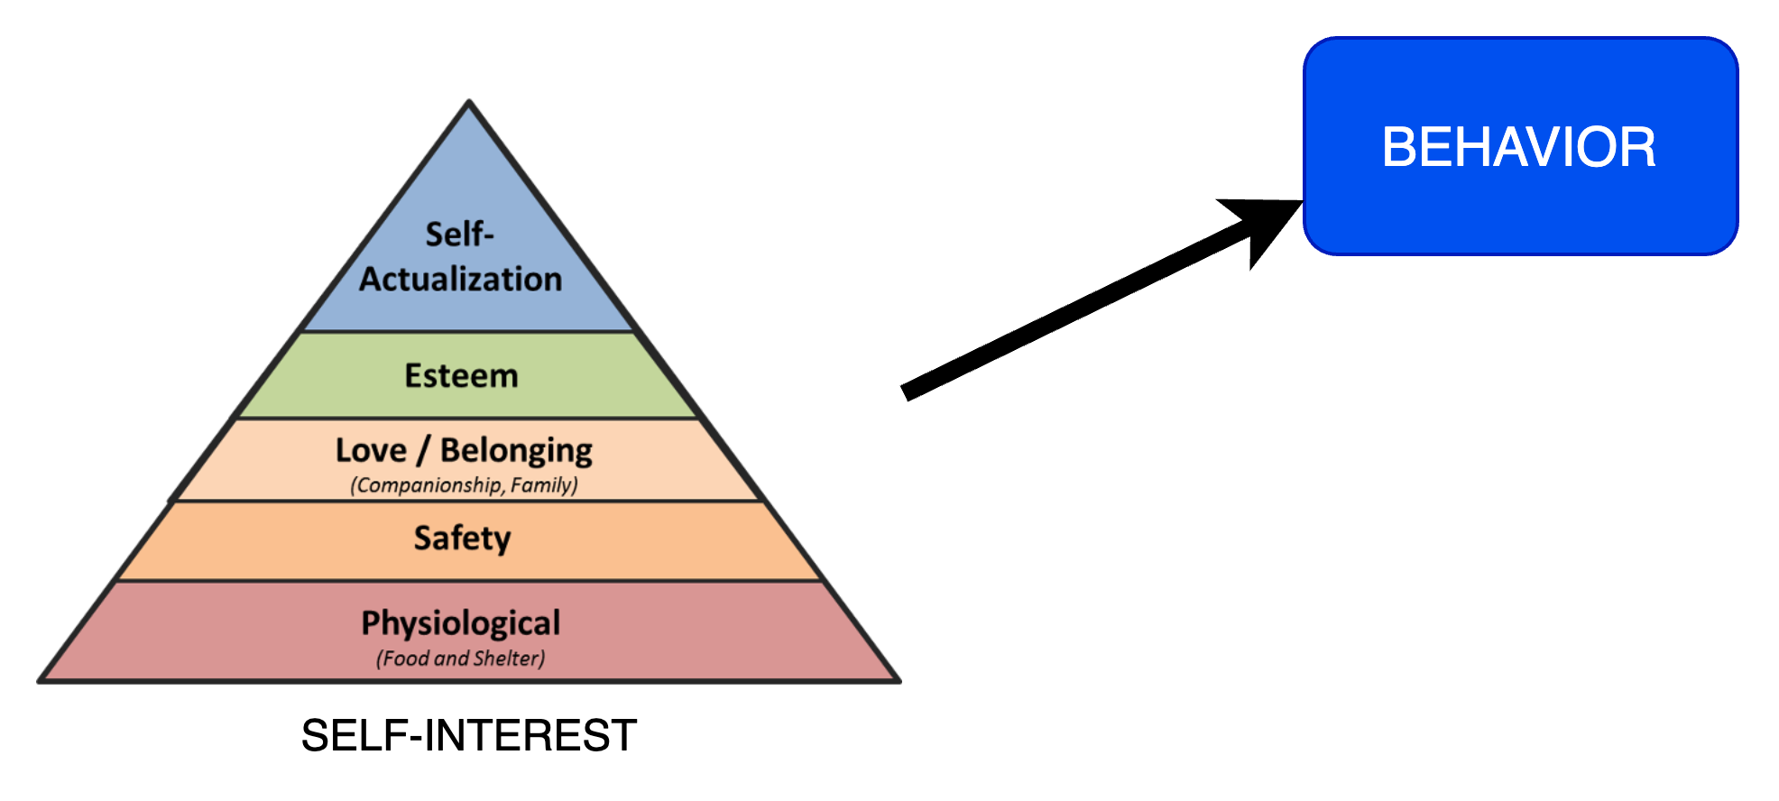
Traditional System
Traditional view of what drives behavior
Relies ONLY on SELF-INTERST (Motivation)
Behavior is intuitively defined
Desired Behavior and TA studied in isolation
(Maslow, 1970)

Slide 15



02
PLAN & PREPARE: DEVELOP QUESTIONS
01
QUERY INDEXED RESEARCH
SOF Operational Research
QUERY WITH OPEN-SOURCE RESEARCH
03
Framework
QUERY CLASSIFIED OPERATIONAL
RESOURCES
06
Security Classification Guide
QUERY WITH ORGANIC OPEN-SOURCE RESEARCH PLATFORMS
QUERY CLASSIFIED INTEL
04
05

Slide 16
Levers of Behavior
Z
Z
x
w
y
Z
Traditional view of what drives behavior
Relies solely on SELF-INTEREST (Motivation)
Reality must account for Capability, Opportunity, and Motivation
(Maslow, 1970)

Slide 17
Levers of Behavior
Z
Z
x
Requires Analysis
y
Z
Traditional view of what drives behavior
Relies solely on SELF-INTEREST (Motivation)
Reality must account for Capability, Opportunity, and Motivation
(Maslow, 1970)

Slide 18
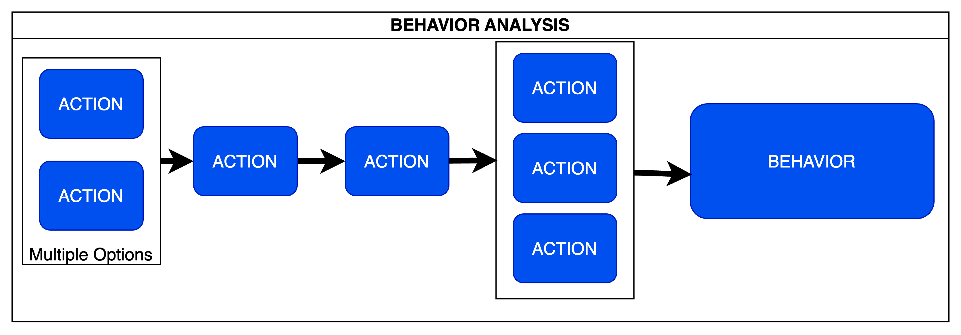
Behavior Analysis
Breaking down the SPO into subordinate behaviors produces an understanding of capability, opportunity, and TA Refinement. This also systematically identifies vulnerable steps.
It involves considering what
SPO identified and reverse planning and research to reveal required subordinate behaviors
Research each subordinate behavior to identify any knowledge or skills required (Capability)
Research each subordinate behavior to identify the locations where each subordinate behavior must take place and the obstacles to accomplishing each. (Opportunity)

Slide 19
Behavior Analysis: Voting
Intermediate B. | Measurable | Required Knowledge | Required Skills | Required Material | Location
1. Register to Vote | Yes | Where to register, how to register, when to register, Requirements to register | Read and Write? Drive to registration | Computer? Phone? Mailing Address? Identification card | Voting Office or DMV
- 1.A Register to Vote Online | Yes | … | …. | …. | Online
- 1.B Register to Vote by Mail | Yes
2. Obtain Ballot | No |  |  | Voter Registration | Mail or Voting Place
3. Fill in Ballot | No | Candidates to vote for, policy to vote for |  | Ballot | Mail or Voting Place
4. Cast Ballot | Yes |  |  | Ballot, Voter Registration | Mail or Voting Place

Slide 20
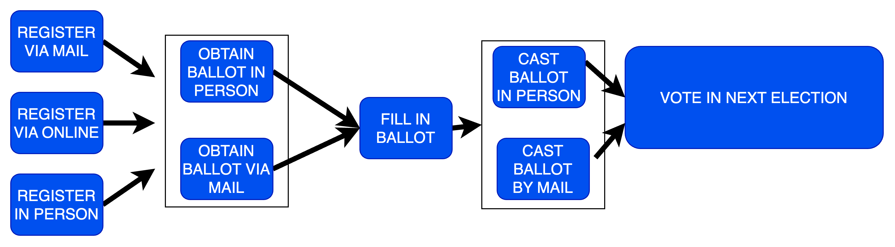
Behavior Analysis : Voting
SPO identified and reversed planning and research to reveal required subordinate behaviors
Research each subordinate behavior to identify any knowledge or skills required (Capability)
Research each subordinate behavior to identify the locations where each subordinate behavior must take place and the obstacles to accomplishing each. (Opportunity)

Slide 21
Behavior Analysis : Voting
What are the requirements to register to vote by mail
What are the deadlines to register to vote by mail
What days does mail get picked up?
How much does it cost to send the mail?
Where are stamps sold?
Where are voter registration forms obtained from?
What are the standard locations for mail drop off

Slide 22
Behavior Analysis : Voting
What are the eligibility criteria for registering to vote in locationX in 202x? Are there any specific residency, age, or citizenship requirements that must be met?
What is the step-by-step process for registering to vote by mail in locationX? Are there different procedures or forms for first-time voters, existing voters updating their information, or individuals with special circumstances?
What are the key deadlines for registering to vote by mail, including submitting voter registration forms and supporting documents? Are there any important dates to be aware of for early voting or absentee ballots?
How does the mail pickup and delivery schedule in locationX impact the voter registration process? Are there specific days or times when mail is picked up, and how can this information be used to ensure the timely submission of voter registration materials?

Slide 23
Behavior Analysis : Voting
What are the postage costs associated with mailing voter registration forms in locationX? Are there any discounts or special rates available for bulk mailing or nonprofit organizations?
Where can individuals purchase stamps for mailing voter registration forms in locationX? Are there any alternative methods for obtaining postage, such as online services or prepaid envelopes?
Where can prospective voters obtain voter registration forms in locationX? Are these forms online and in-person available at various locations, such as government offices, libraries, or community centers?

Slide 24
Behavior Analysis : Voting
What are the standard locations for mail drop-off in locationX, including post offices, blue mailboxes, and authorized mail collection sites? Are there any restrictions or guidelines for using these mail drop-off locations, such as hours of operation or size limitations?
Are there any additional resources or support services available in locationX to assist individuals in the voter registration process, such as voter registration drives, workshops, or community outreach programs?
How can individuals in locationX verify their voter registration status or update their information if needed? What steps should be taken if an individual encounters issues or concerns during voter registration?

Slide 25
Behavior Analysis : Voting
What are the requirements to register to vote online
What are the deadlines to register to vote online
What is the website?
How is the registration form filled out?
What requirements exist to fill out a voter registration form?

Slide 26
Behavior Analysis : Voting
What are the requirements to register to vote in person
What are the deadlines to register to vote in person
What are the standard locations for in-person registration

Slide 27
Behavior Analysis : Voting
Registering to vote in the AOR requires registration to be submitted by DATE1 for registration by mail, DATE2 for registration in person or online (Last Name). Forms to register by mail can be printed from the website WEBSITE name (INTEL Report#)

Slide 28
Combine Behavior with Audience
Who needs to perform the action or behavior to have the greatest impact = audience.
Where will the audience need to do this action or behavior?
What does the audience need to do differently to achieve the desired outcome?
When will the audience need to do this action or behavior?
How often will the audience do this action or behavior?
With who will the audience do this action or behavior?

Slide 29
02
PLAN & PREPARE: DEVELOP QUESTIONS
01
QUERY INDEXED RESEARCH
SOF Operational Research
QUERY WITH OPEN-SOURCE RESEARCH
03
Framework
QUERY CLASSIFIED OPERATIONAL
RESOURCES
06
Security Classification Guide
QUERY WITH ORGANIC OPEN-SOURCE RESEARCH PLATFORMS
QUERY CLASSIFIED INTEL
04
05

Slide 30
Levers of Behavior
Z
Z
COM-B
Requires Analysis
y
Z
Traditional view of what drives behavior
Relies solely on SELF-INTEREST (Motivation)
Reality must account for Capability, Opportunity, and Motivation
(Maslow, 1970)

Slide 31
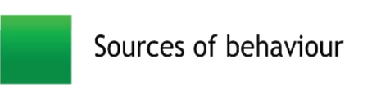
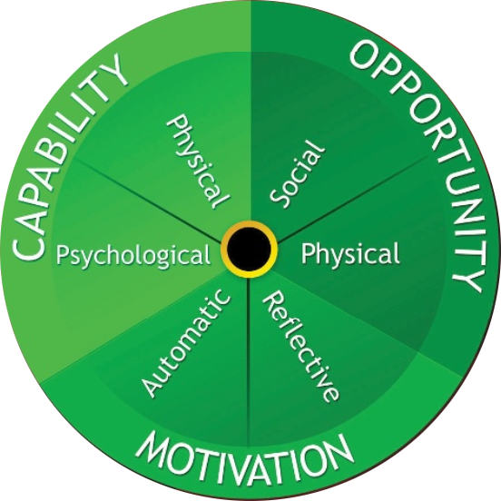
The Behavior Change Wheel: COM-B
Capability: an individual’s psychological and physical capacity to engage in the activity concerned.
Opportunity: all the factors that lie outside the individual that make the behavior possible or prompt it.
Motivation: all those brain processes that energize and direct behavior, not just goals and conscious decision-making.
(Michie et al., 2011)
Notes:
capability, we distinguished between physical and psychological capability (psychological capability being the capacity to engage in the necessary thought processes - comprehension, reasoning et al.).
opportunity, we distinguished between physical opportunity afforded by the environment and social opportunity afforded by the cultural milieu that dictates the way that we think about things (e.g., the words and concepts that make up our language).
motivation, we distinguished between reflective processes (involving evaluations and plans) and automatic processes (involving emotions and impulses that arise from associative learning and/or innate dispositions)
As groups have students s

Slide 32
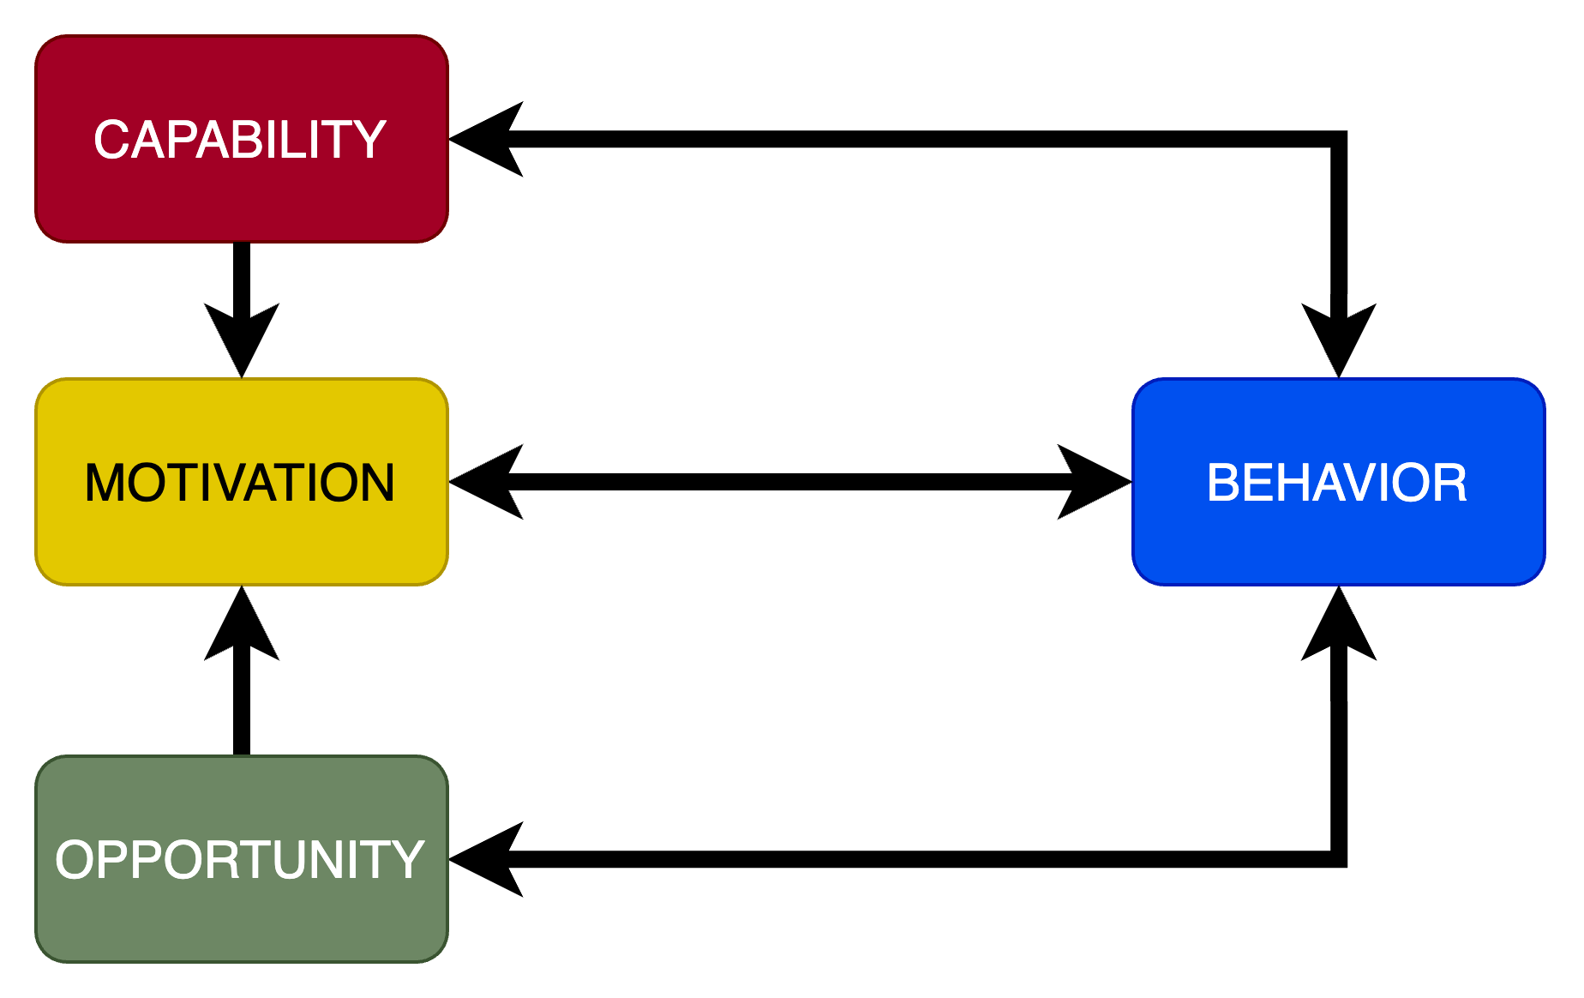
The COM-B System
(Michie et al., 2011)
Conduct research on behaviors based on the specific environmental conditions in which they occur and the requirements necessary for their successful execution.
Focus on measuring and observing behaviors in a way that allows for objective assessment rather than relying on subjective sentiment.
Recognize that motivation to perform a behavior is influenced by the individual's opportunity and capability. Following the behavior, positive or negative reinforcement can impact future motivation to act on the behavior.

Slide 33
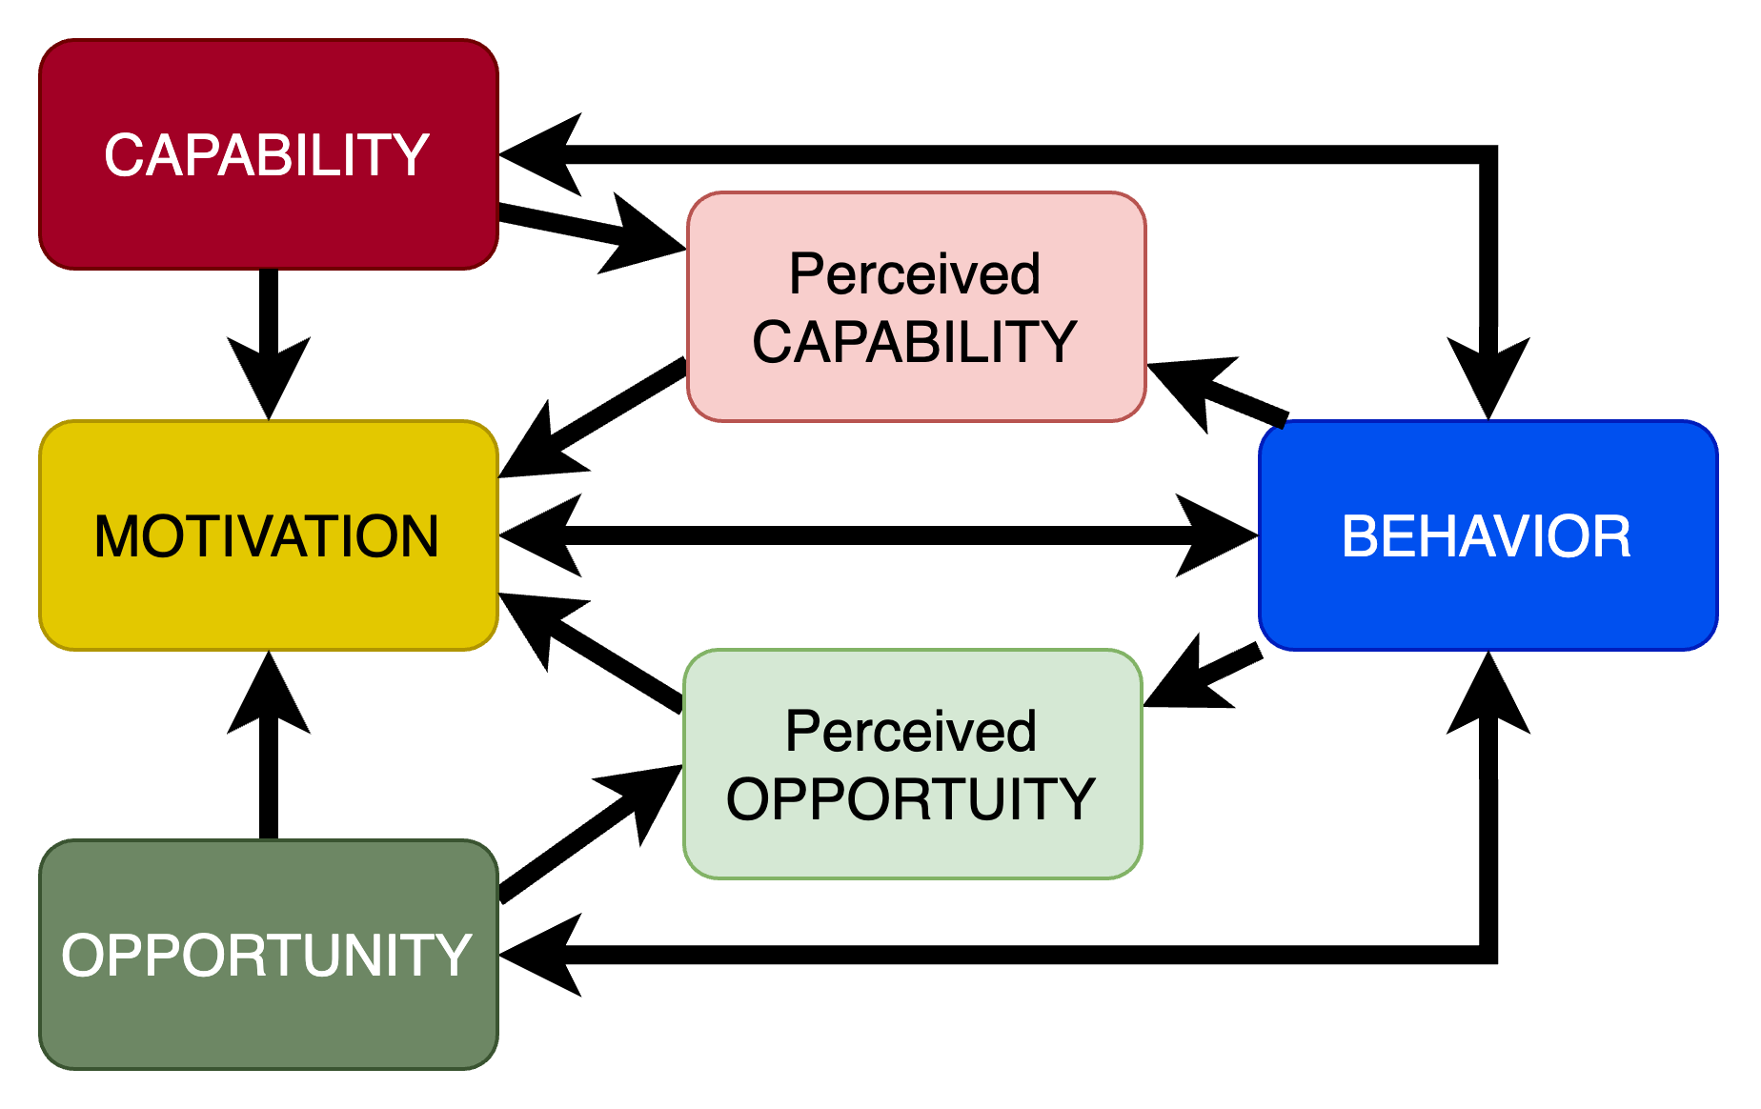
Accounting for Perception
(Michie et al., 2011)
Conduct research on behaviors based on the specific environmental conditions in which they occur and the requirements necessary for their successful execution.
Focus on measuring and observing behaviors in a way that allows for objective assessment, rather than relying on subjective sentiment.
Recognize that motivation to perform a behavior is influenced by the individual's opportunity and capability to do so. Following the behavior, positive or negative reinforcement can impact future motivation to perform the behavior.

Slide 34
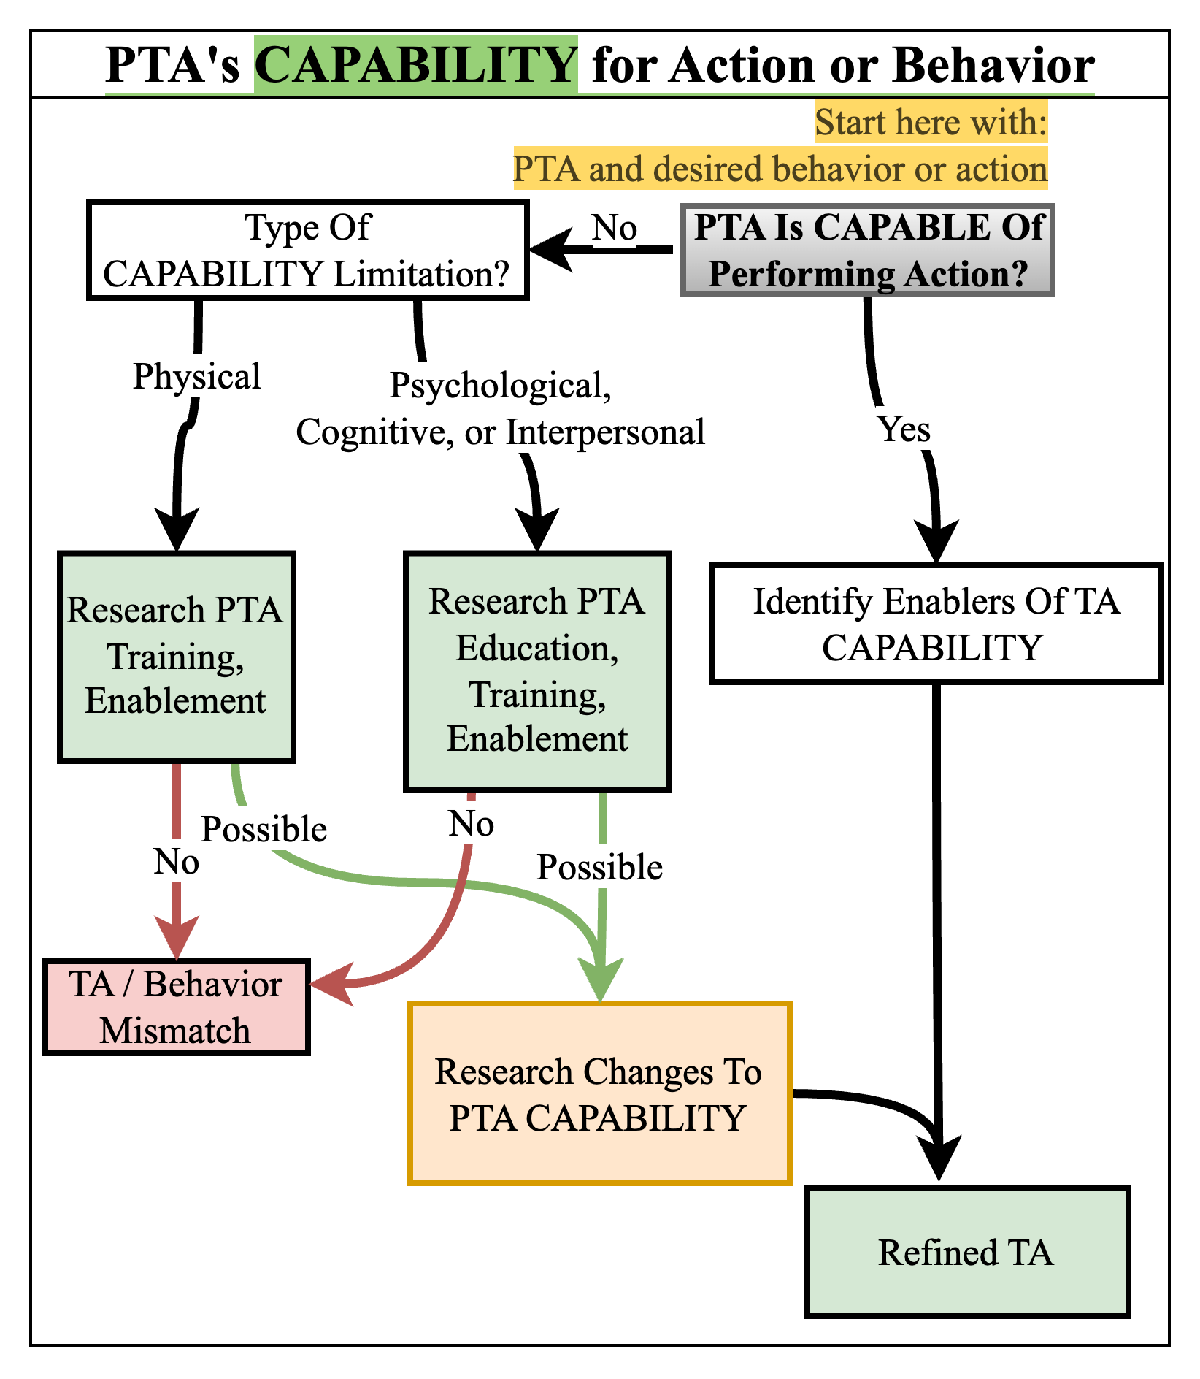
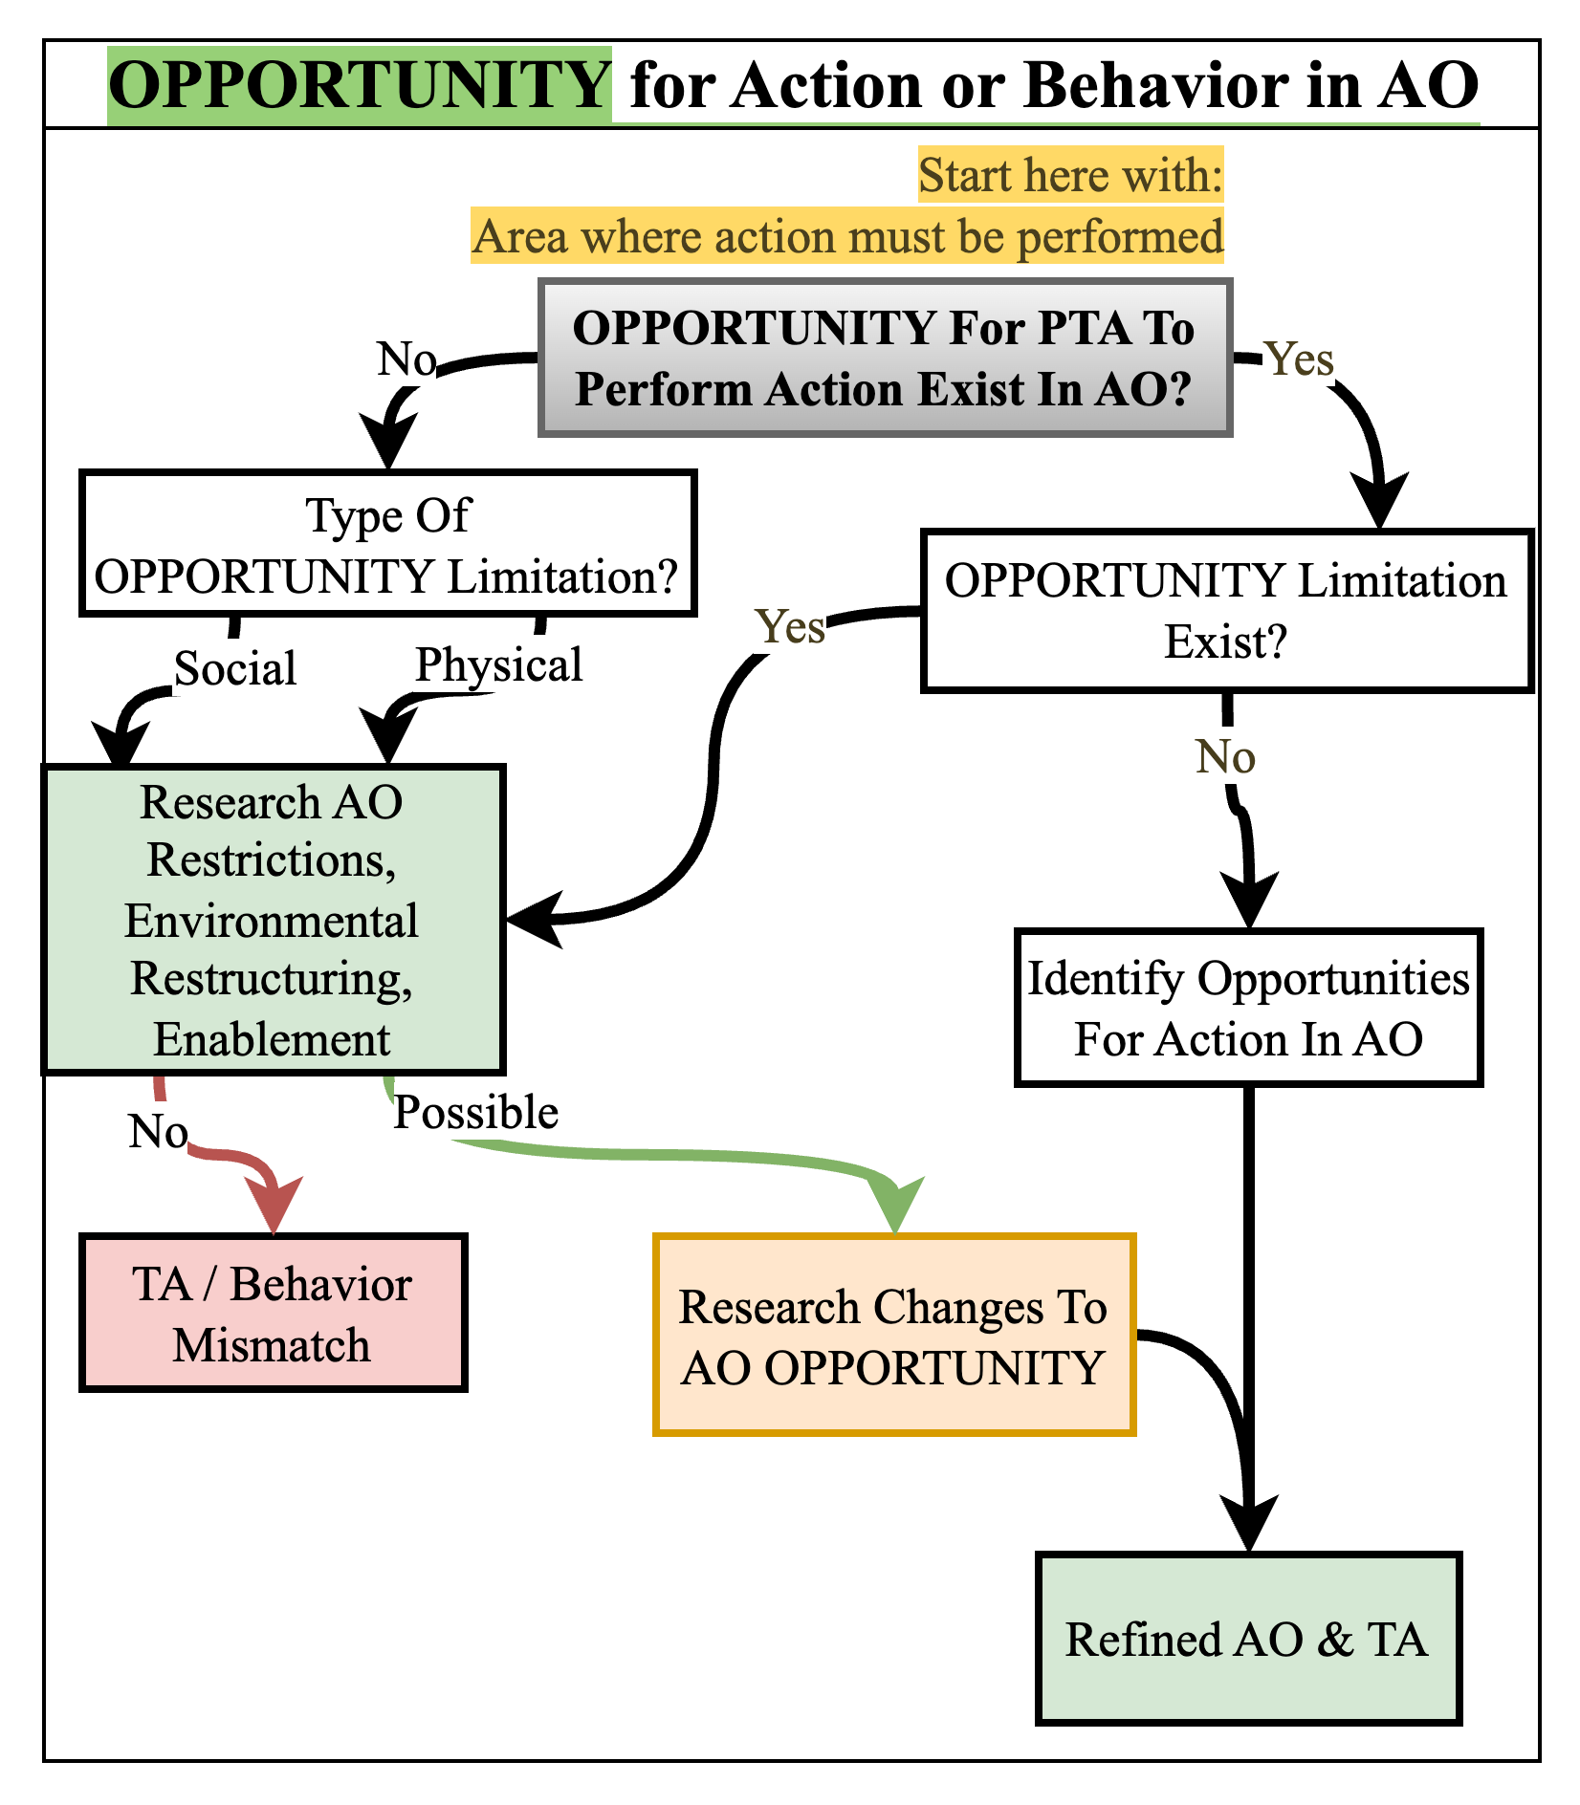
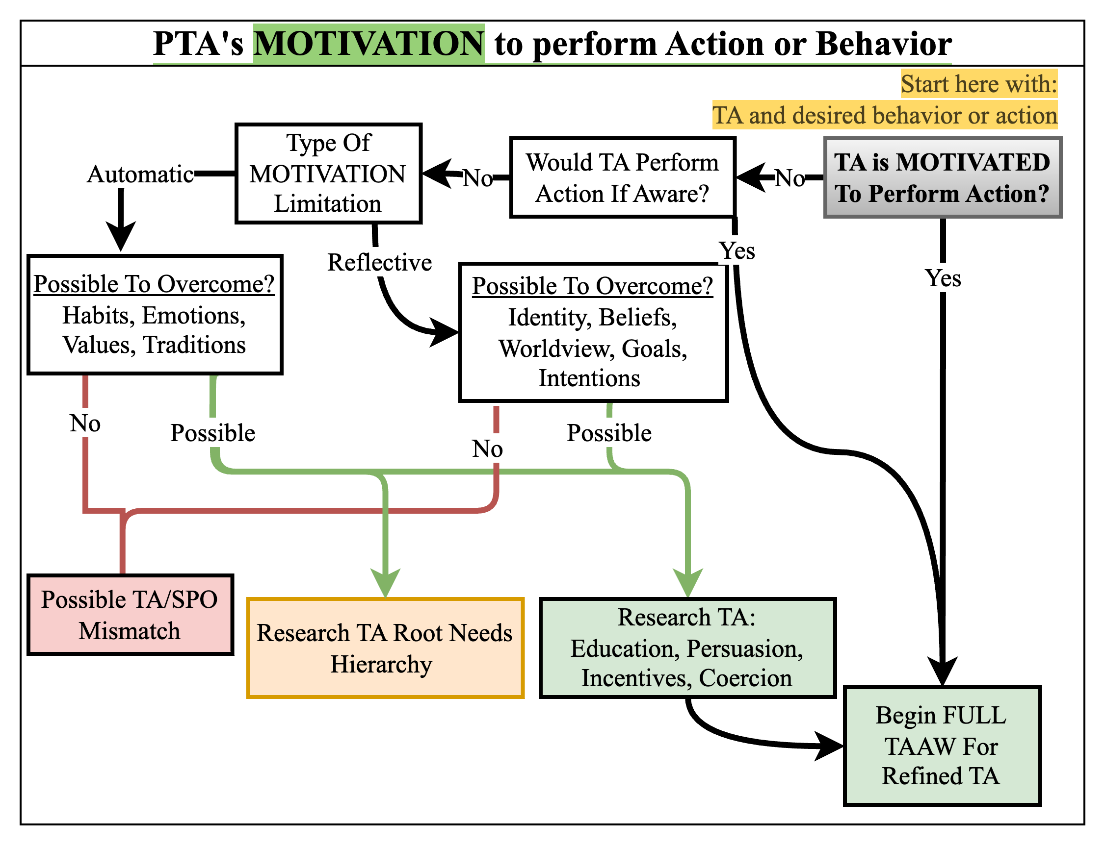
Researching COM-B
(Michie et al., 2011)

Slide 35
Researching COM-B
(Michie et al., 2011)

Slide 36
Researching COM-B
(Michie et al., 2011)

Slide 37
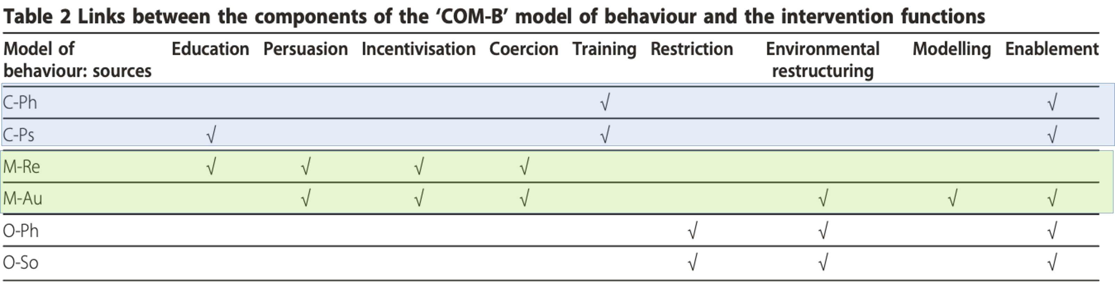
COM-B Recommends Action
(Michie et al.)

Slide 38
Levers of Behavior
Z
Z
COM-B
Requires Analysis
Overcoming Lack of Motivation
Z
Traditional view of what drives behavior
Relies solely on SELF-INTEREST (Motivation)
Reality must account for Capability, Opportunity, and Motivation
(Maslow, 1970)

Slide 39
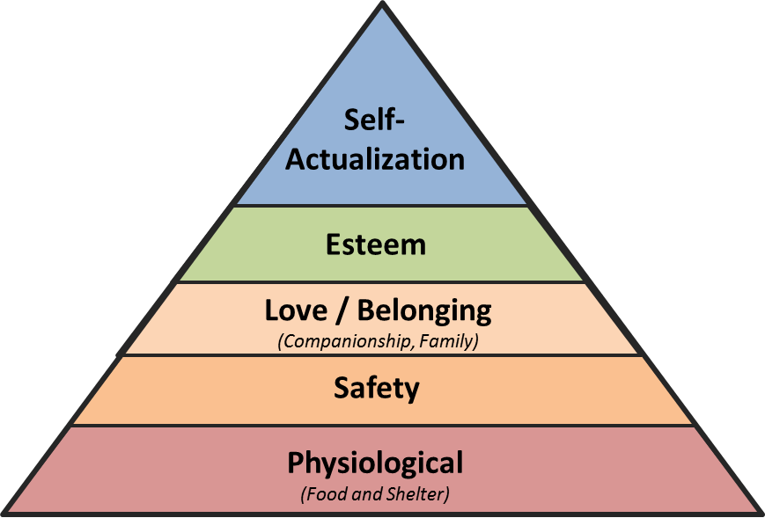
Overcoming Task Motivation
with Self-Interest
Overcoming Lack of Motivation
TA’s Self-Interest
TA’s Self-Interest
(Michie et al.)
The direct motivation to perform an subordinate behavior differs from the overall needs and is influenced by all factors.
The needs hierarchy can impact motivation to perform an action, even if it doesn't impact capability or opportunity.
When considering the needs hierarchy, evaluate the various perceived actions and their potential impact on motivation.
(Maslow, 1970)

Slide 40
SOF Operational Research
Other Behavior
Other Behavior
COM-B
Requires Analysis
Overcoming Lack of Motivation
Other Behavior
Traditional view of what drives behavior
Relies solely on SELF-INTEREST (Motivation)
Reality must account for Capability, Opportunity, and Motivation
(Maslow, 1970)

Slide 41
Your Supporting MISO Objective
.. NOT the TA’s Only Option
Overcoming Lack of Motivation
TA’s Self-Interest
(Michie et al., 2011)
(Maslow, 1970)

Slide 42
Context Slide
Students will recall all the elements of Behavior
Students will recall the Order for planning and research
Students will break down a behavior/task as a class
Students will recall the COM-B System
Apply

Slide 43
Levers of Behavior
Other Behavior
2
6
Other Behavior
COM-B
4
Overcoming Lack of Motivation
Requires Analysis
3
Overcoming Lack of Motivation
1
5
Other Behavior
Traditional view of what drives behavior
Relies solely on SELF-INTEREST (Motivation)
Reality must account for Capability, Opportunity, and Motivation
(Maslow, 1970)

Slide 44
Behavior Analysis:
Command Climate Survey
Apply

Slide 45
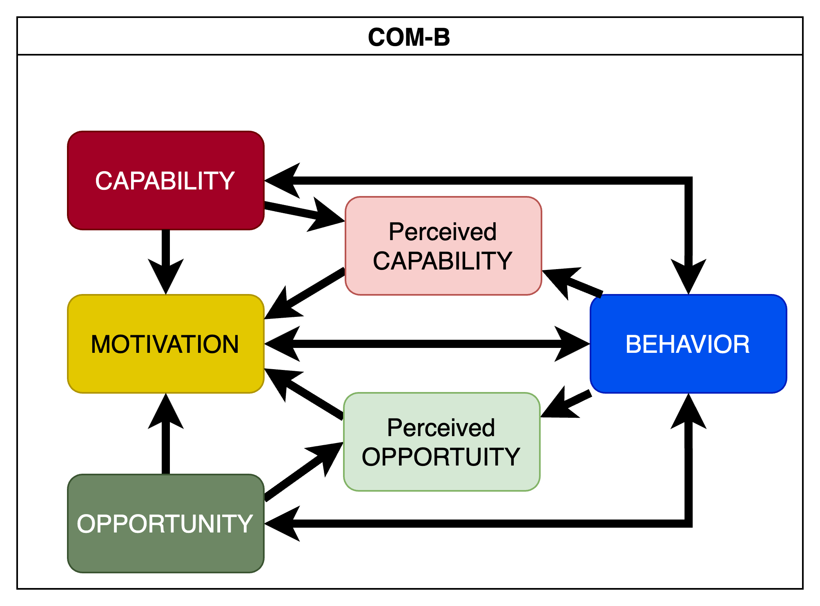
COM-B System
Apply

Slide 46
Context Slide
Student centered again, do less talking than the student.
Ask the student:
How they can change their current TTPs
How can Behavior Analysis be maintained for Knowledge Management
What arguments they envision their leadership having
How they would respond to these identified arguments

Slide 47
02
PLAN & PREPARE: DEVELOP QUESTIONS
01
QUERY INDEXED RESEARCH
SOF Operational Research
QUERY WITH OPEN-SOURCE RESEARCH
03
Framework
QUERY CLASSIFIED OPERATIONAL
RESOURCES
06
Security Classification Guide
QUERY WITH ORGANIC OPEN-SOURCE RESEARCH PLATFORMS
QUERY CLASSIFIED INTEL
04
05
Develop

Slide 48
Works Cited
Maslow, A. H. (1970). Motivation and personality (2d ed). Harper & Row.
Michie, S., Van Stralen, M. M., & West, R. (2011). The behaviour change wheel: A new method for characterising and designing behaviour change interventions. Implementation Science, 6(1), 42. https://doi.org/10.1186/1748-5908-6-42
The Psychological Operations Force Influence Process Task: Analyze. (2022). Headquarters, Department of the Army. https://armypubs.army.mil/ProductMaps/PubForm/Details.aspx?PUB_ID=1025079
Notes:
(Michie et al., 2011)
(Maslow, 1970)
(TM 3-53.11, 2022)

